Slide 1
Showing Connections between Investment and City Growth
Merging statistical and clustering approaches to study growth
FERNANDO MEIRA,
SPRINGBOARD CAPSTONE PROJECT– DATA SCIENCE INTENSIVE

Slide 2
OVERVIEW
Project Description
Introduction
The challenges of measuring growth
The methods
Data Set
Results
Conclusions
Future Work
Consulted References

Slide 3
PROJECT DESCRIPTION
Showing Connections between Investment and City Growth
Hyperplanes distance comparison (I-Distance method)
Merging I-Distance with K-Means clustering
Modelling growth and finding patterns between cities

Slide 4
INTRODUCTION
The challenges on measuring growth
The culture of using GDP
HDI and the first multidimensional approach to growth
Alternatives for HDI and the actual trends

Slide 5
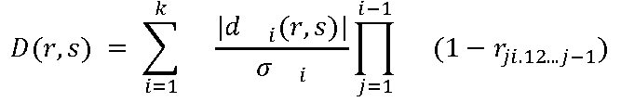
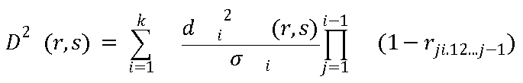
INTRODUCTION
The methods
The I- Distance method

Slide 6
INTRODUCTION
The methods
K-Means clustering
Using the clustering methods to see if I-Distance ranking matches clustering
Find growth patterns within clustering

Slide 7
DATASET
The data set used for this study was merged from two sources:
Investment (public and private) values by year
http://dados.gov.br/dataset
The rest of the features (demographics, social, economic, etc.)
http://www.imp.seade.gov.br/

Slide 8
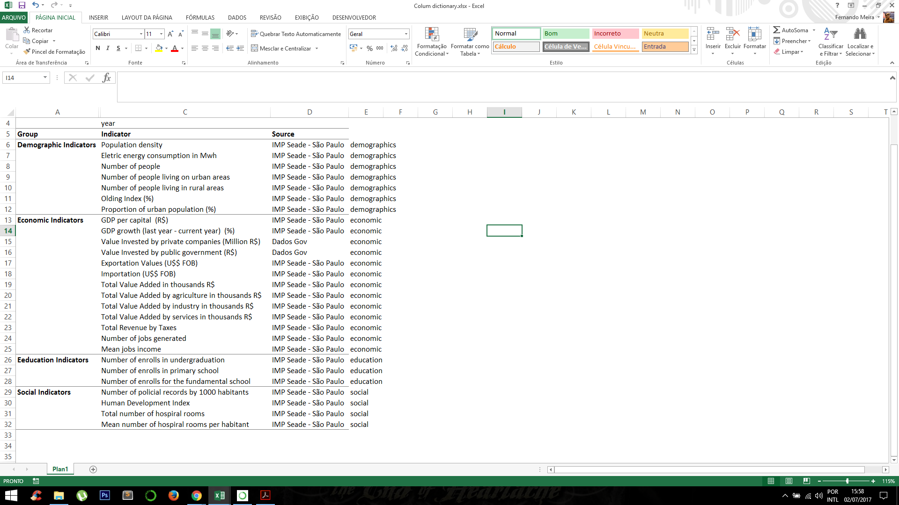
DATASET
The data ranged from the years 2000 to 2016 for all the 645 cities of the province of São Paulo, Brazil

Slide 9
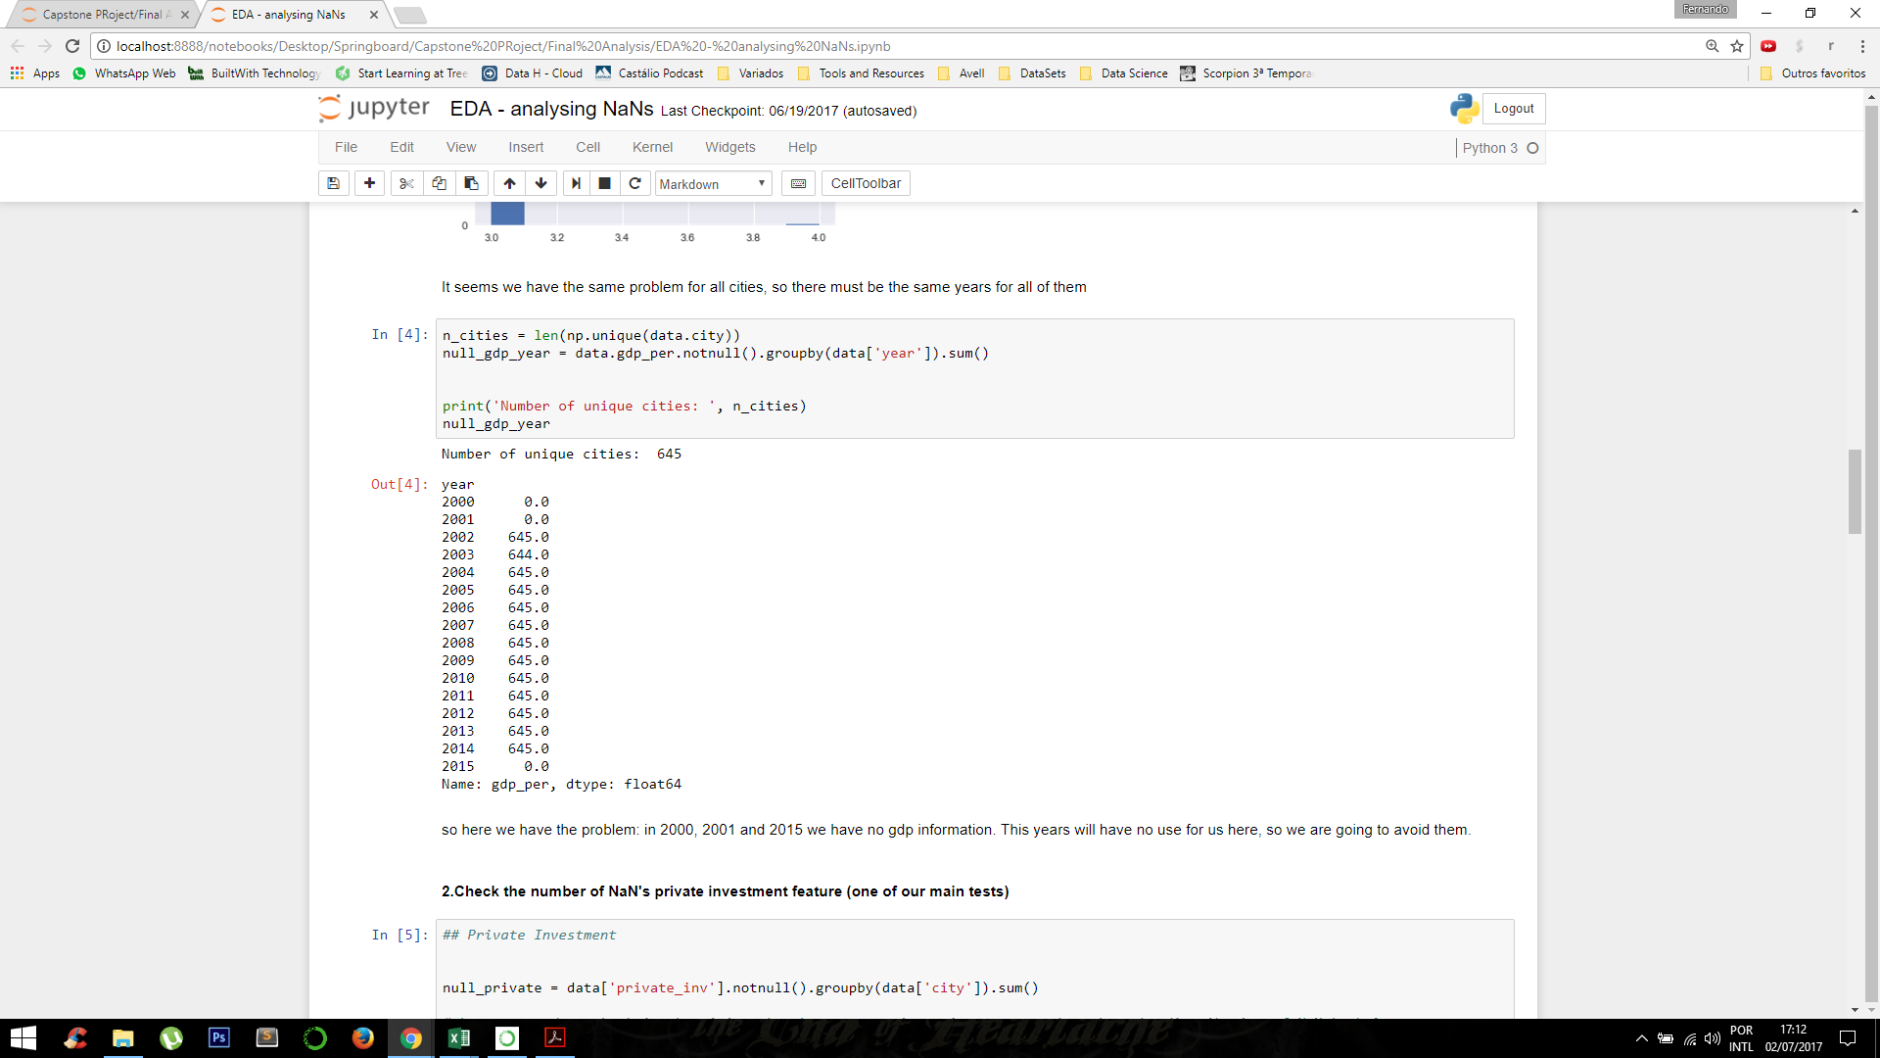
DATASET
Data Cleaning:
Here we could conclude that 2000, 2001 and 2015 were years that should not be used to this analysis, once there were no entries for any one of them.
Number of entries for GDP per capita variable, per year

Slide 10
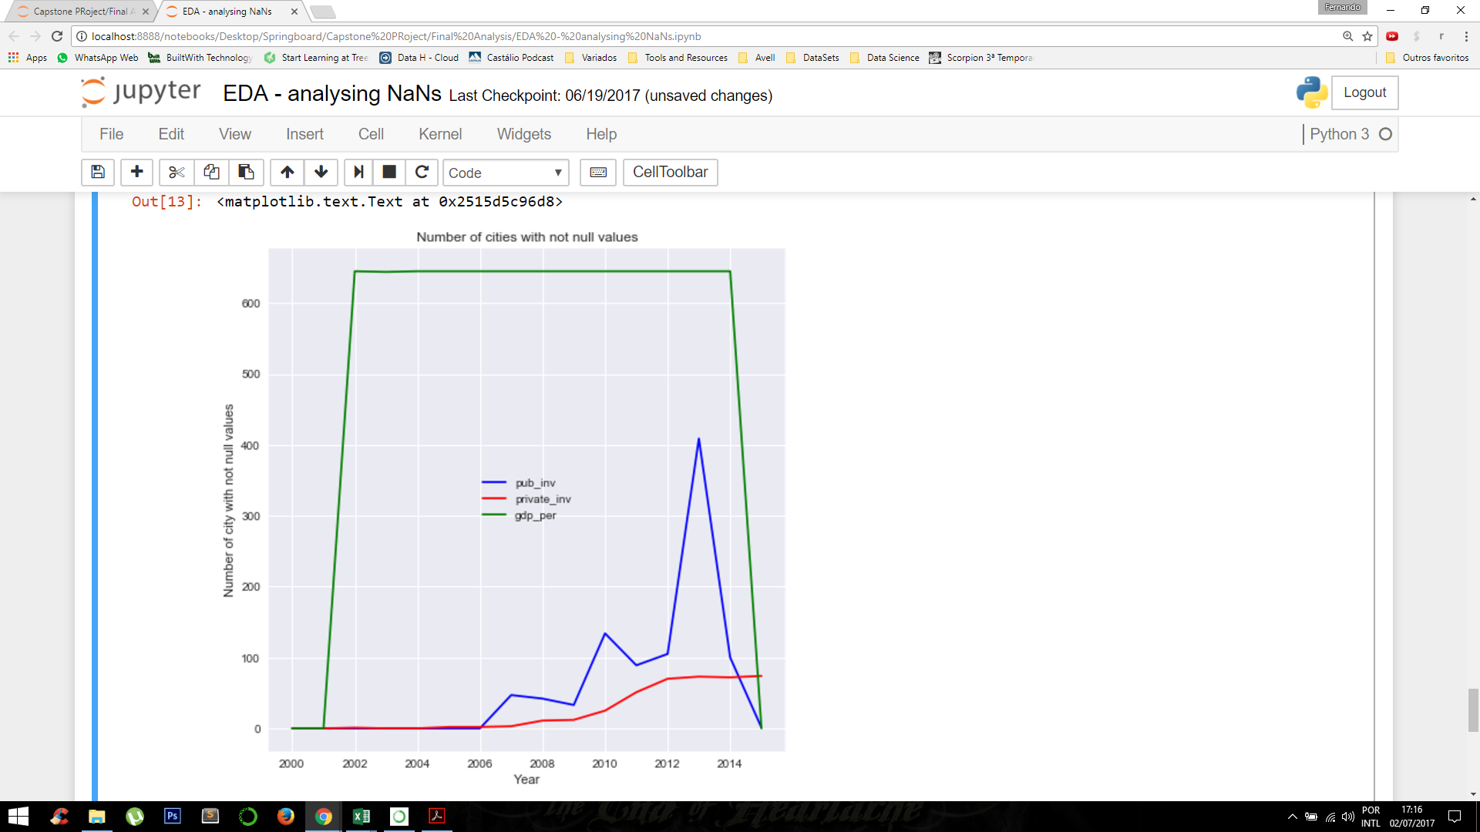
DATASET
Data Cleaning:
Considering that our main features of interest are GDP per capita, public, and private investment, year 2013 is a clear choice for the analysis.
Number of entries for the 3 main features, by year

Slide 11
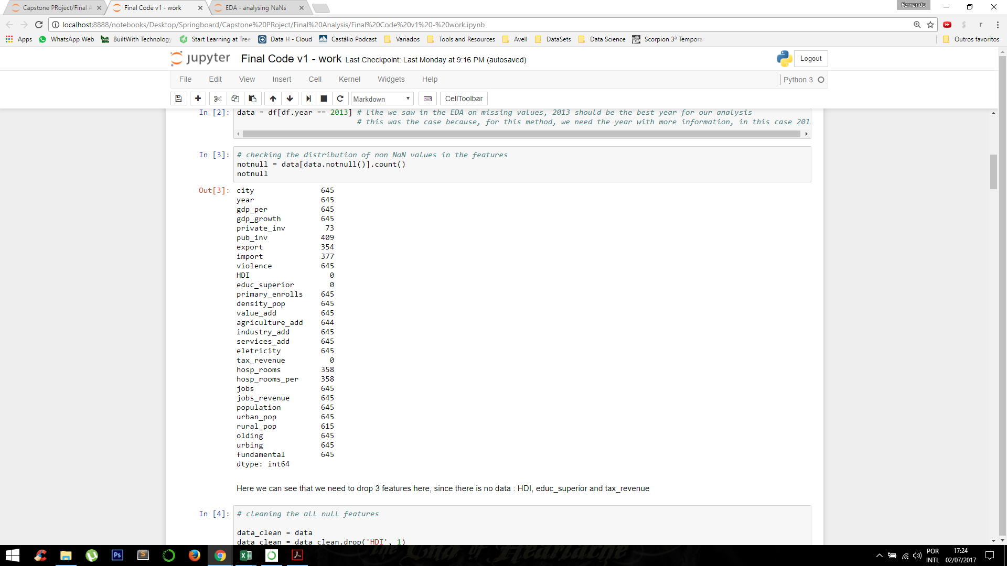
DATASET
Data Cleaning:
Since 2013 is the year of choice, we need to check the values for all the indicatorts in this particular year:
Number of entries for the 3 main features, by year

Slide 12
DATASET
Data Cleaning:
Since 2013 is the year of choice, we need to check the values for all the indicatorts in this particular year:
Dropped!
Number of entries for the 3 main features, by year

Slide 13
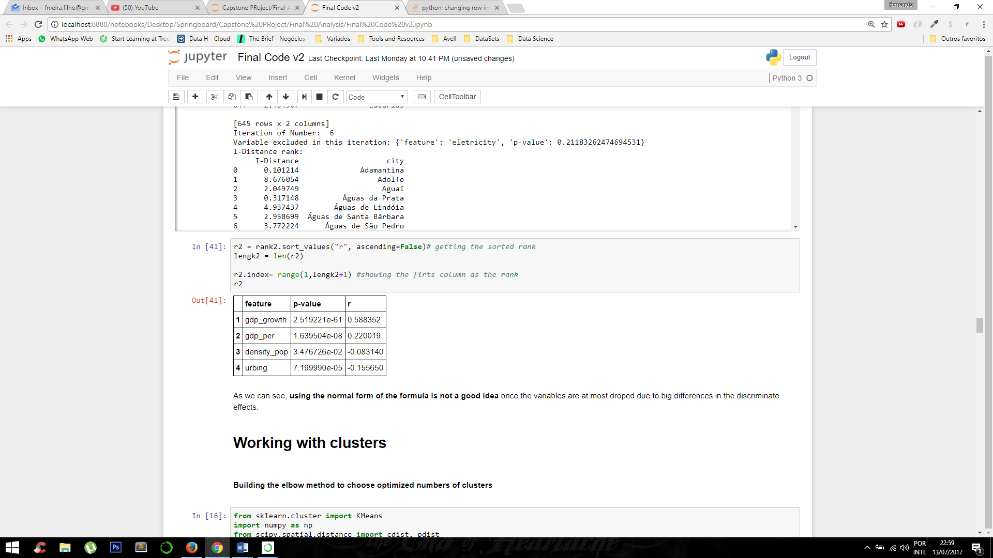
RESULTS
Choosing between the best version of I-Distance method: squared or non-squared?
Not Squared Results
Method | Number of iterations | Number of excluded features | Features that remained
Non-Squared | 20 | 20 | gdp_growth; gdp_per; density_pop; urbing
Squared | 7 | 7 | violence; jobs; services_add; valued_add; urban_pop; population; hosp_rooms; fundamental; pub_inv; electricity; industry_add; rural_pop; import; export; density_pop; jobs_revenue; gdp_per
Number of iterations and excluded features for the I-Distance calculation
Rank of features relevance for the not squared I-Distance

Slide 14
RESULTS
Choosing the best version of I-Distance method for this project: squared or not squared?
Not Squared Results
Method | Number of iterations | Number of excluded features | Features that remained
Not Squared | 20 | 20 | gdp_growth; gdp_per; density_pop; urbing
Squared | 7 | 7 | violence; jobs; services_add; valued_add; urban_pop; population; hosp_rooms; fundamental; pub_inv; electricity; industry_add; rural_pop; import; export; density_pop; jobs_revenue; gdp_per
Weakness of this version
Number of iterations and excluded features for the I-Distance calculation
Rank of features relevance for the not squared I-Distance

Slide 15
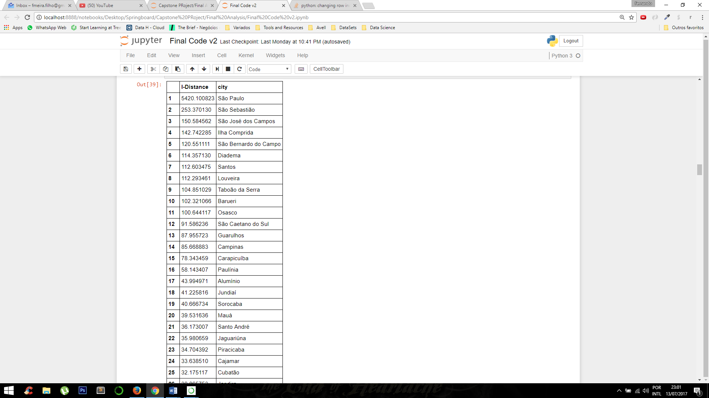
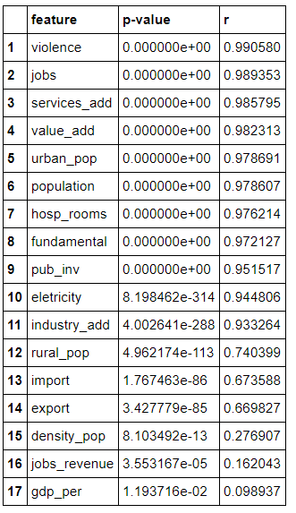
RESULTS
Squared Results
Rank of features relevance for the squared I-Distance
Rank of cities for the squared I-Distance (best positioned cities)

Slide 16
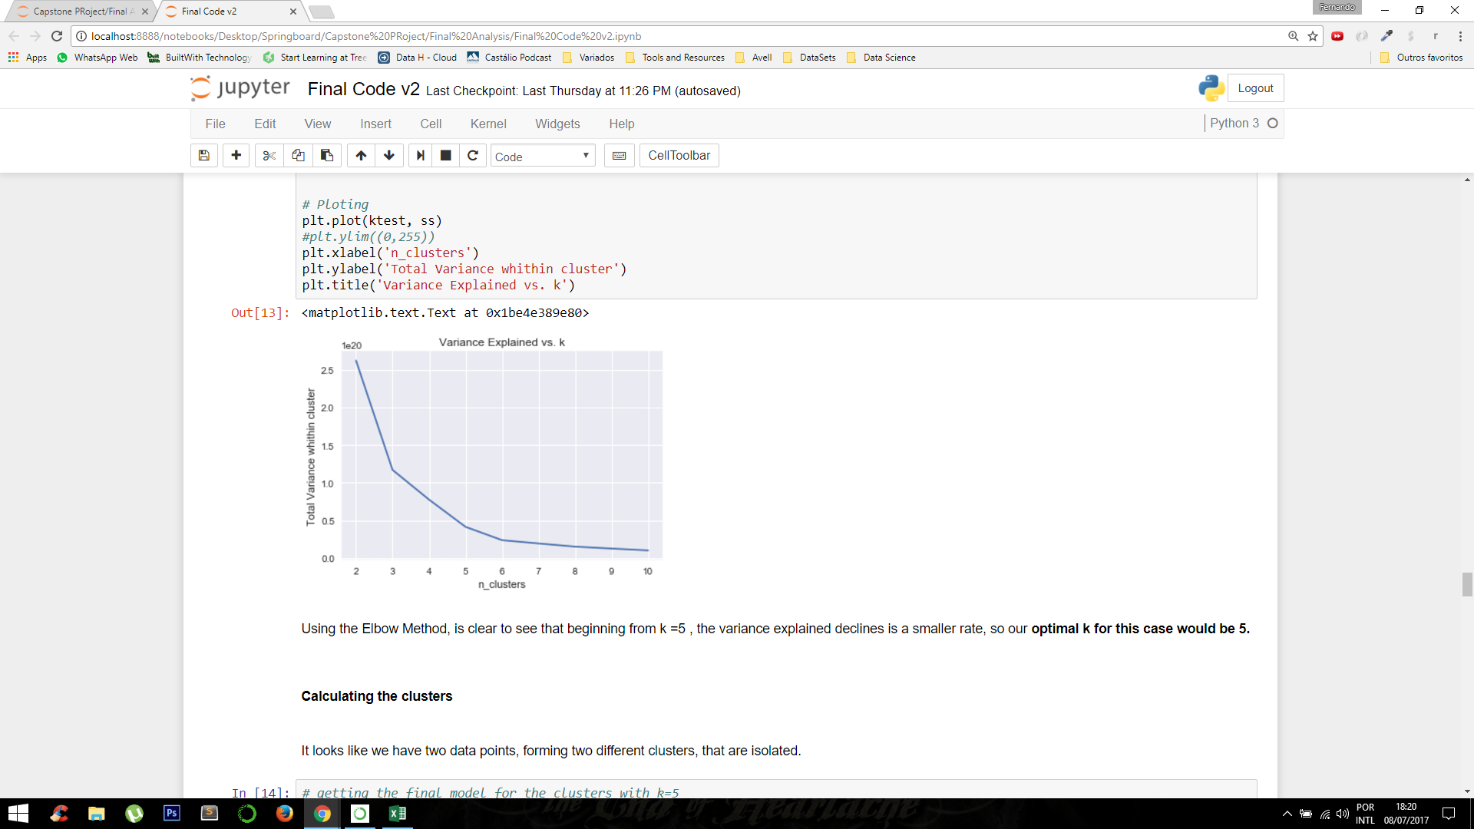
RESULTS
Preparing for clustering: The Elbow Method
Variance explained versus the number of centroids chosen

Slide 17
RESULTS
Preparing for clustering: The Elbow Method
Optimal choice
Variance explained versus the number of centroids chosen

Slide 18
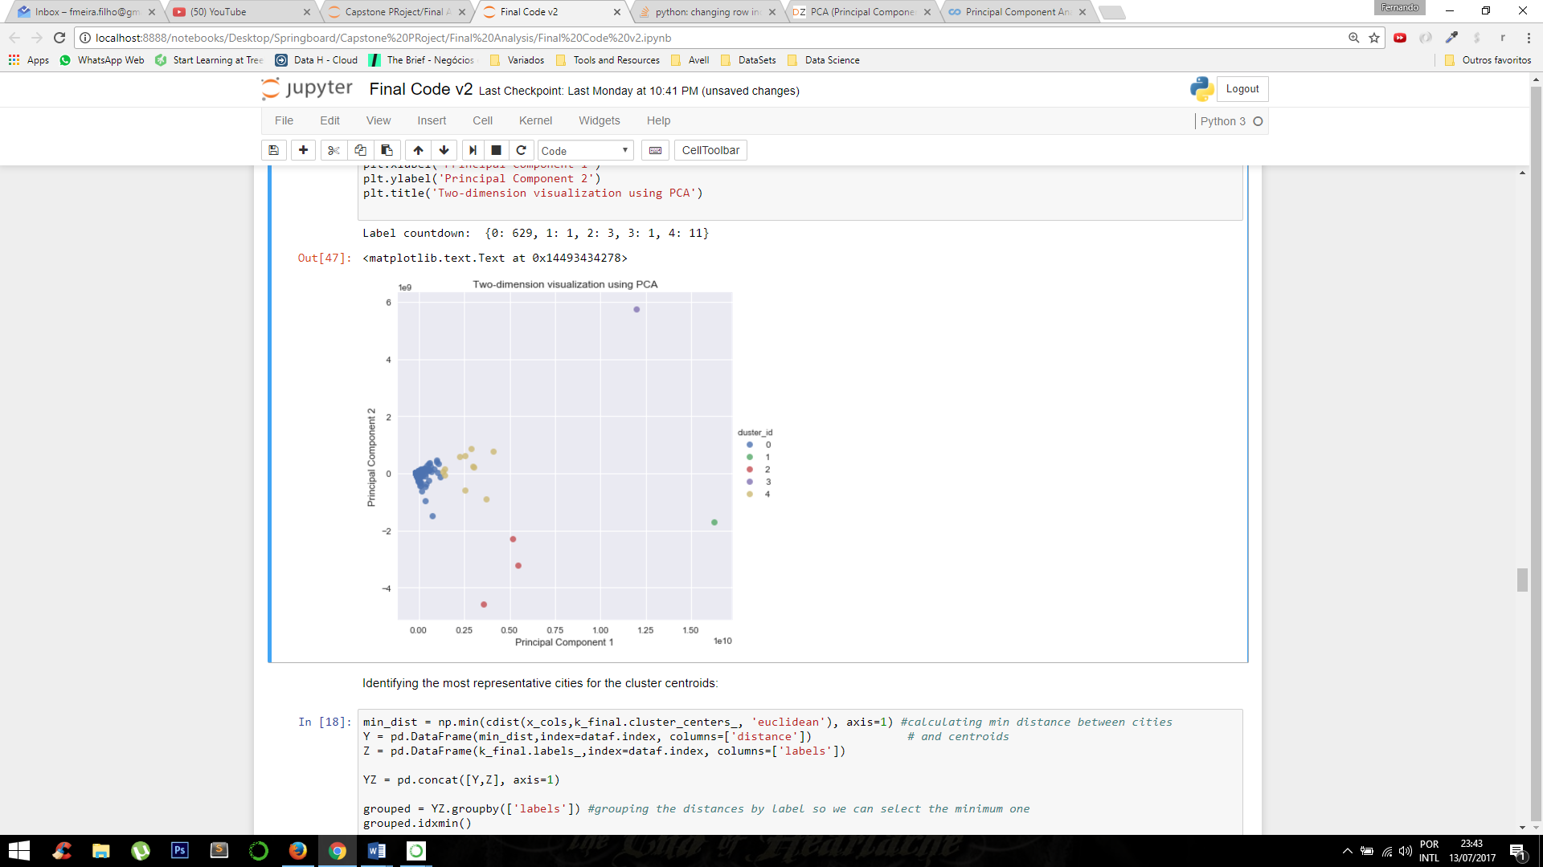
RESULTS
K-Means results for K=5
2D visualization using PCA
The distribution of the clusters using all the features

Slide 19
RESULTS
K-Means results for K=5
Cluster_id | Most representative city | I-Distance Squared Rank
0 | Porto Feliz | 228
1 | São Paulo | 1
2 | Taubaté | 29
3 | São Sebastião | 2
4 | São José dos Campos | 3
Cluster centroids are used as the most representative cities

Slide 20
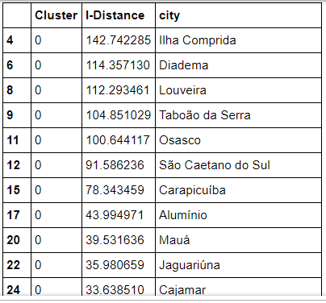
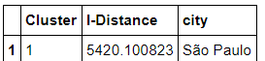
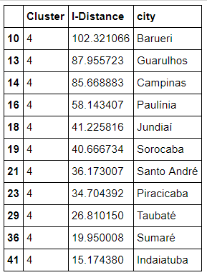
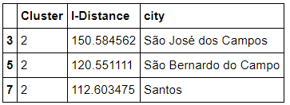
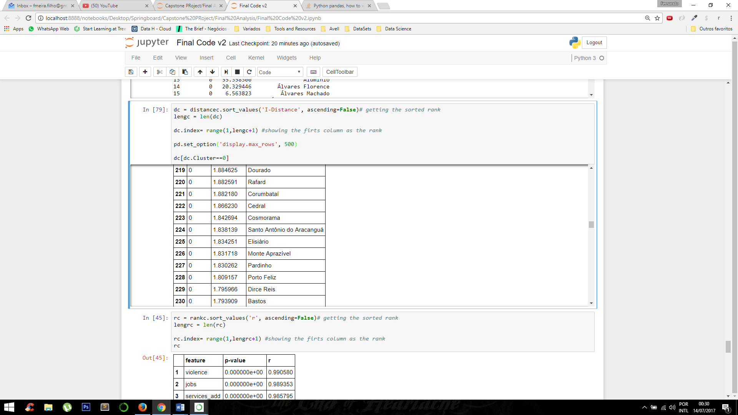
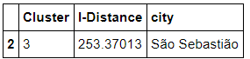
RESULTS
Rank of cities for the I-Distance using the clustering labeling
Cluster 1
Cluster 2
Cluster 0
Cluster 4
Cluster 3

Slide 21
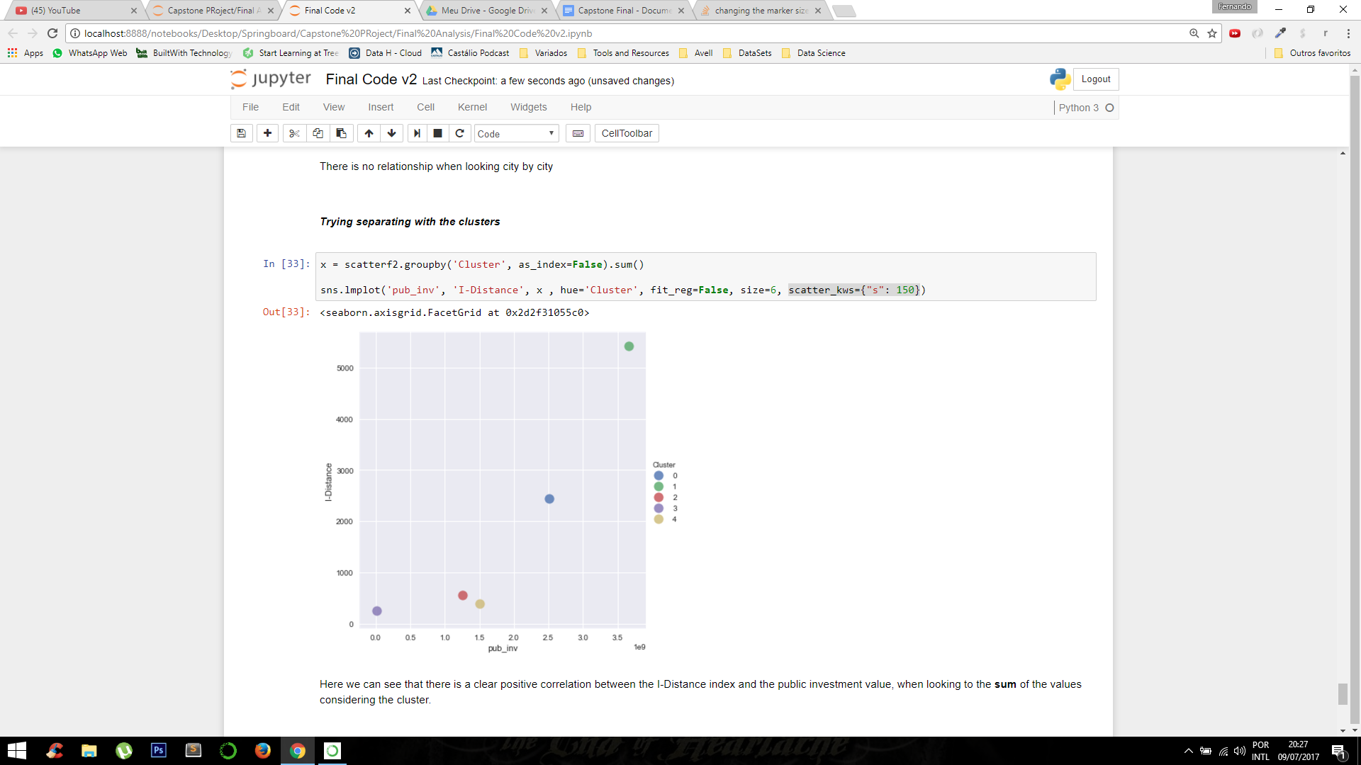
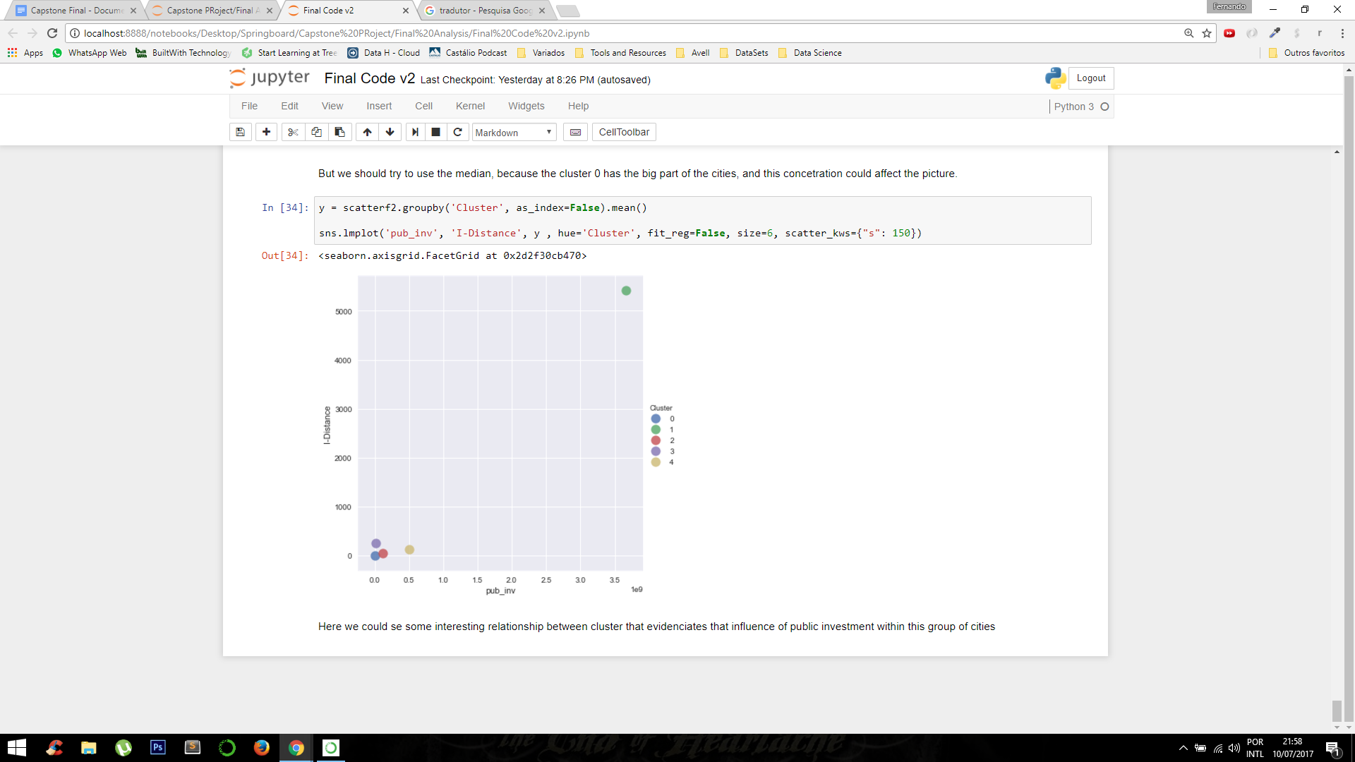
RESULTS
Visualizing I-Distance results grouping cities with cluster labels
Scatter plot of the sum of I-Distance and public investment by cluster
Scatter plot of the mean of I-Distance and public investment by cluster

Slide 22
CONCLUSIONS
Private investment seems to be not relevant for the period of the study
Public investment relatively relevant for the modellig of growth when looking the I-Distance with the clustering
Results of the model align with perceptions of cities’ growth for most cities

Slide 23
FUTURE WORK
Deeper look variables other than investment
Deeper study of the high positioned cities looking for patterns
Add more features related to technology, such as internet access
Try to apply the method to more recent data

Slide 24
CONSULTED REFERENCES
[1] N. Milenkovic, et alia: "A multivariate approach in measuring socio-economic development of MENA countries". In Economic Modeling 38 (2014) 604-608. Available from http://www.sciencedirect.com/science/journal/02649993/38
[2] J. Bang, et alia: "New Tools for Predicting Economic Growth Using Machine Learning: A Guide for Theory and Policy".. Available from: https://www.researchgate.net/publication/291827961_New_Tools_for_Predicting_Economic_Growth_Using_Machine_Learning_A_Guide_for_Theory_and_Policy
[3] N. Adriansson, et alia: "Forecasting GDP Growth, or How Can Random Forests Improve Predictions in Economics? " . Available from: https://pdfs.semanticscholar.org/d402/473ba628b67bcd0d3a8cf39799ae6efbdc66.pdf

Slide 25
THE END
TITLE
AUTHOR
SHOWING CONNECTIONS BETWEEEN INVESTMENT AND CITY GROWTH
Fernando Meira
Economist
Ribeirão Preto, SP – Brazil
fmeira.filho@gmail.com
Merging statistical and clustering approaches to study growth

